Slide 2
YOUR NEW-GENERATION
SOLUTION PARTNER

Slide 3
ABOUT US?
The largest privately-owned investment bank in Turkey
Services in corporate and investment banking with its leading service model
Turkey with 13 branches offices located throughout the corporate banking, investment banking and private banking
Annual compound growth rate of 32 % in 2022
A total of 200 awards proving its innovative perspective
11 million clients serviced in the field of wholesale
banking (18 % of the market)
OUR SUBSIDIARIES
Active on 250 thousand devices
20% market share in Turkey Pos devices market
Android Pos Services
400 thousand processing point in 200 countries
Turkey’s first domestic, global Money transfer and payment platform
The one and only insurance and reinsurance broker offering its services through its multi-channel structure
Operating in 15 countries involved in Turkey and nearby regions
High quality electronic security service for housing, SME’S , large companies and the public sector
7 million monthly transactions
500 transactions centers, 3,500 kiosks
The largest paying agency of Turkey
It operates in the fields of energy, construction, real estate, mining, textile, finance and telecommunications.
Maintaining its operations in 34 countries in Central Asia, Balkans and the MENA region, the group currently employs approximately 16 thousand people.
6.3 million users
Passomobil is the most comprehensive , entertaintment and event application in Turkey
Digital solution partner and personnel employment
service for construction industry
In addition to E-Kent, Passolig and N Kolay Ankara operations; Solution partner of Ankara, Bolu, Düzce, Kahramanmaraş, Kayseri, Kilis, Kütahya, and Aksaray Municipalities
Service providing Sports & Event Ticketing, Access Control & Public Transport & Smart City Solutions
Aktif Ventures, which builds, grows and invests in end-to-end financial technology, operates as a “fintech venture founder”.
Aktif Tech offers high value-added software solutions and end-to-end operations services to all its customers.
It is the first international Islamic financial institution established by cooperation the Islamic Development Bank and Aktif Bank
The first interest-free "Short-Term Lease Certificate/Sukuk" of Turkey, convenient for trading on daily basis
It has investments and activities in many sectors such as renewable energy, electronic security solutions and human resources consultancy.
Consultancy Services for R&D and technology
based SMEs and start-ups

Slide 4
BİZ KİMİZ?
İştiraklerimiz aracılığıyla geliştirdiğimiz eşsiz büyüme modeli
Incorporation
of Emlak Girişim
Incorporation
of Aktif Ventures
Incorporation
of Aktif Tech
Change of Trade Name and Management Assets: 58 mio USD
Incorporation of N Kolay, and Realization of Passolig
Incorporation of UPT
*Incorporation of EchoPOS
1999
2008
2013
2015
2018
Incorporation
of Secom
2020
Incorporation of Calik Bank
Acquirement of EKent
Incorporation of Pavo and Sigortayeri
Incorporation
of Aktif Portföy
Incorporation
of İnnovaban
Incorporation
of Workindo
2010
2014
2016
* September
2019
2022
2007

Slide 5
ECHOPOS
ABOUT ?

Slide 6
ABOUT US?
"OPENING BELL CEREMONY HELD FOR ECHOPOS"
Aktif Bank, the largest privately-owned investment bank in Turkey, launched a joint venture titled "EchoPos" in September 2016 with Robotpos, a leading company in payment systems and automation, through Borsa Istanbul Private Market.

Slide 7
EKİBİMİZ
82
NUMBER OF OUR EMPLOYEES
32
%17
AVERAGE AGE
R&D / IT TEAM SIZE
%33
%67
FEMALE EMPLOYEES
MALE EMPLOYEES

Slide 8
ABOUT US?
A SALES EXPERIENCE TOUCHING ON FUTURE
Echo Bilgi Yonetim Sistemleri A.S. with its business operations initiated in September 2016 under the brand of EchoPOS;
aims to be the most-preferred "New-Generation Solution Partner" in the wholesale industry, and to take place on the top across the industry with its end-to-end payment systems and integration solutions for front and back offices of enterprises by the end of 2021.
Windows-based automation systems operating in an integrated manner with the new-generation cash registers of Ingenico brand
Alternative "Mobile-Based" solutions for SMEs

Slide 9
SEE MORE
LEASE INSTEAD OF PURCHASE
NEW-GENERATION
SOFTWARE ARCHITECTURE
FLEXIBLE INTEGRATION STRUCTURE
Pay as you earn
Service Offering
No investment cost
Opportunity to keep up with the up-to-date technology
Robust infrastructure
Satisfaction of requirements by enterprises with a focus on solution
Easy integration
Low costs
Easy management from a single center
REAL-TIME AND
TWO-WAY COMMUNICATION
CENTRAL MANAGEMENT
END-TO-END TECHNICAL SUPPORT AND
SERVICE
Real-time information flow
Easy management of important information
Follow up of sales and price changes
Access to all branches with a single touch
Access to, and customization of cash register management
Option to grant a personal access authorization
Accessible across Turkey
Exact and effective solution opportunities
Working with a single technical support and service provider

Slide 10
SEE MORE
CAMPAIGN MANAGEMENT
LOYALTY CARD MANAGEMENT
IOS/ANDROID LOYALTY
(OPTIONAL)
Easy campaign management
Media publications on campaigns
Filtering by shops or regions
Being able to work in an integrated manner with all collaborative companies
Easy access to all bonus, cheque and loyalty card details
Services exclusive to brands
Compatibility with popular operating systems
MODULAR INFRASTRUCTURE
PLUG-AND-PLAY INSTALLATION
EASY TRAINING & PRACTICAL USE
Integration of all other services, you would like to utilize, into the system
Gathering all services under a single roof
Ready-to-use
Customized for shops
Mobile
Ease of learning and using, enabling cashiers to get familiar with cash transactions
Shortening of the waiting periods of customers

Slide 11
ECHOPOS
SOFTWARE

Slide 12
ORGANIZED WHOLESALE SOLUTION
PAYMENT SYSTEMS
CRD
Integration with 19 banks
Meal card applications
INTEGRATION SOLUTIONS
ERP

Slide 13
ECHOPOS
HARDWARE SET

Slide 14
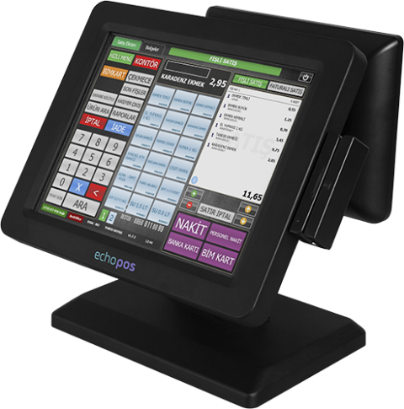
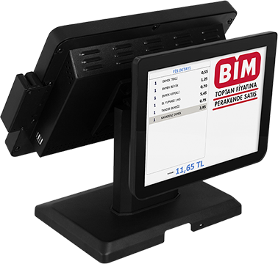
ECHOPOS HARDWARE SET
ECHOPOS PCPOS MODEL 1
Operating System: Windows 10, WIN SQL Express, WIN SQL Light
Central Processing Unit: Intel Celeron J1900 Quad Core Fanless CPU
Memory: 4GB Ram
Disc: 64GB SSD
Monitor: 12’’ Touch Screen LCD (1024x768), 5-Wire Resistive Touch
Customer Indicator: 10’’ IPS Panel TFT LCD Monitor/Supports images and videos

Slide 15
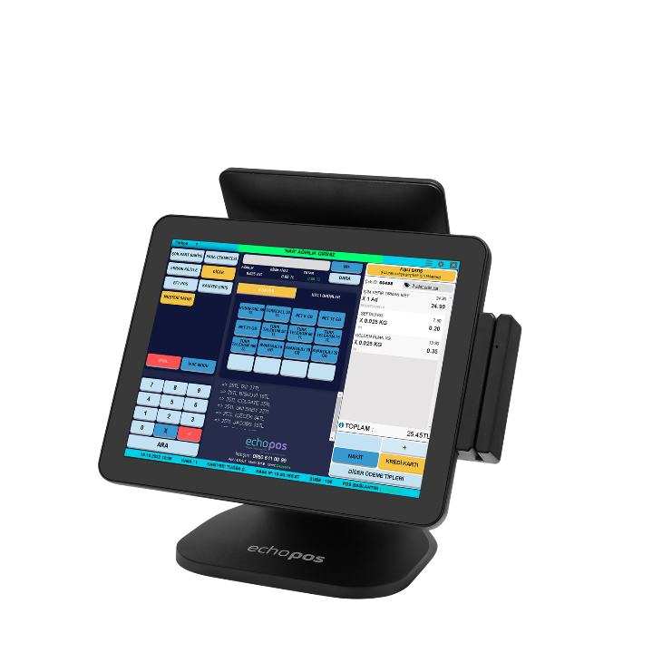
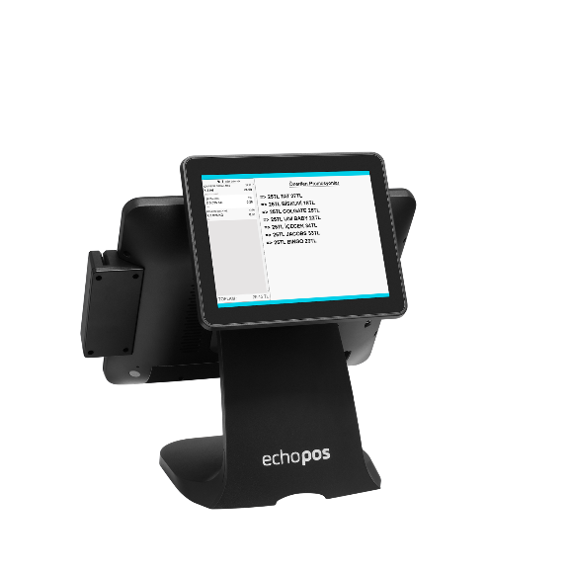
ECHOPOS HARDWARE SET
ECHOPOS W9 PCPOS MODEL
Operating System: Windows 7 ,Windows 10 (Trial Version), WIN SQL Express, WIN SQL Light
Central Processing Unit: Intel Celeron J1900 Quad Core Fanless CPU
Memory: 4GB Ram
Disc: 128GB SSD
Monitor: 15’’ Touch Screen LCD (1024x768), Capacitive Touch
Customer Indicator: 9.7’’ IPS Panel TFT LCD Monitor/Supports images and videos

Slide 16
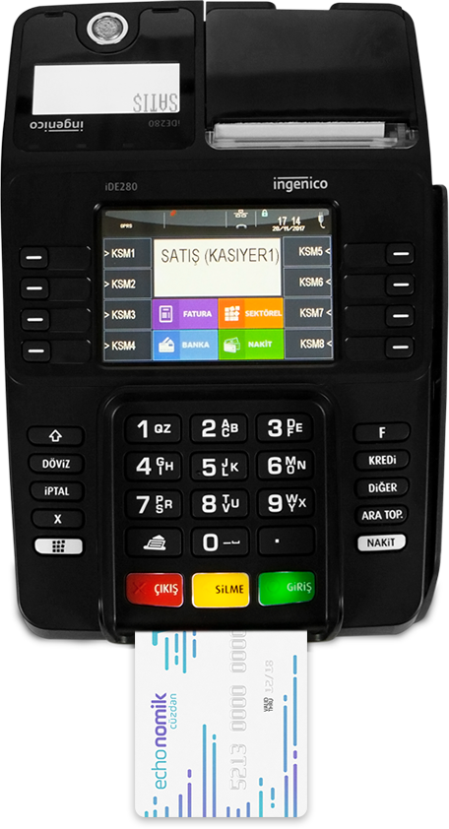
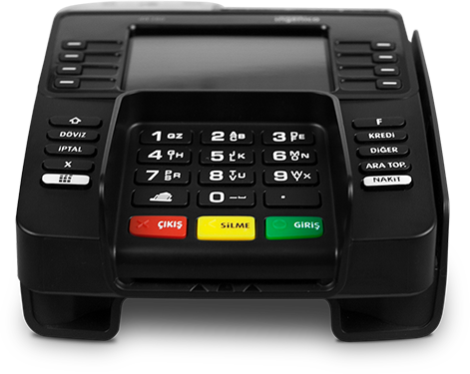
ECHOPOS HARDWARE SET
INGENICO IDE 280
Central Processing Unit: 32 Bit, 450 Mhz
Memory: 64 MB RAM / 128 MB Flash (up to 32GB)
Wire Communication: 3xUSB, RS232, Drawer port, Ethernet
Keyboard: On-screen pop-up keyboard with 4 X 4 keys – 18 function keys
Video Player: Yes
Thermal Printer: 18 Lines/Sec. – 50mm Paper Roll – 30 meters
Power Supply: 12 V 2,5A
Mechanic: 50 km
Dimensions & Weight: 215,5 x 144,6 x 700 mm. 694 Grams

Slide 17
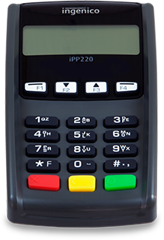
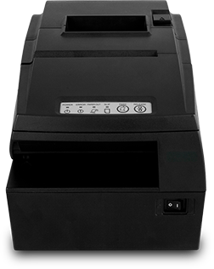
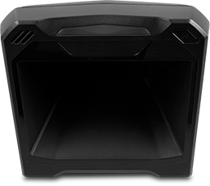
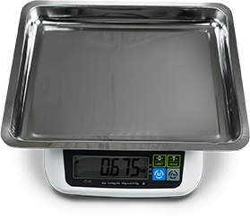
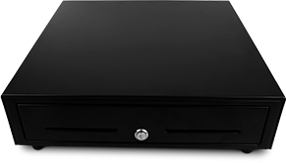
ECHOPOS HARDWARE SET
OTHER PRODUCTS
INGENICO PINPAD
BARCODE READER
ELECTRONIC BALANCE
3’’ THERMAL PRINTER
CASH DRAWER
Ingenico IDE 280 new-generation desktop cash register POS
Barcode Dimensions: 1D – 2D
Main Computer Interface: IBM 46XX,
Keyboard Wedge, Serial, USB
Dimensions & Weight: 96.8 mm-143 mm
148.8 mm / 499 g
Operating Temperature Range: -10 40
Supply: DC 9V
Indicator type: LCD
Product Weight: 2.8kg
Print method: Directly thermal line printing
Dot Density: 512/576 dot lines
Print Speed: 250 mm /sec
Print Width: 79.5+/-0.5 mm
Interface: Serial, USB, Ethernet
5 paper, 8 coin units
Operable with 12v / 24v
Locking system and electric opening
Cold steel and SECC structure

Slide 18
ECHOPOS HARDWARE SET
ECHOPOS: THE EASIEST POS
ECHOPOS offers
CALL CENTER SUPPORT SERVICES
Different financial models
Provides service between 08:00-22:00 every day.
Optional On-Site Support Service (SLA)
Real-time and two-way communications protocols
Mobile and web applications
New-generation cash registers with no initial investment cost
ECHOPOS: THE SMARTEST POS

Slide 19
ECHOPOS
CATALOGUE

Slide 20
CATALOGUE

Slide 21
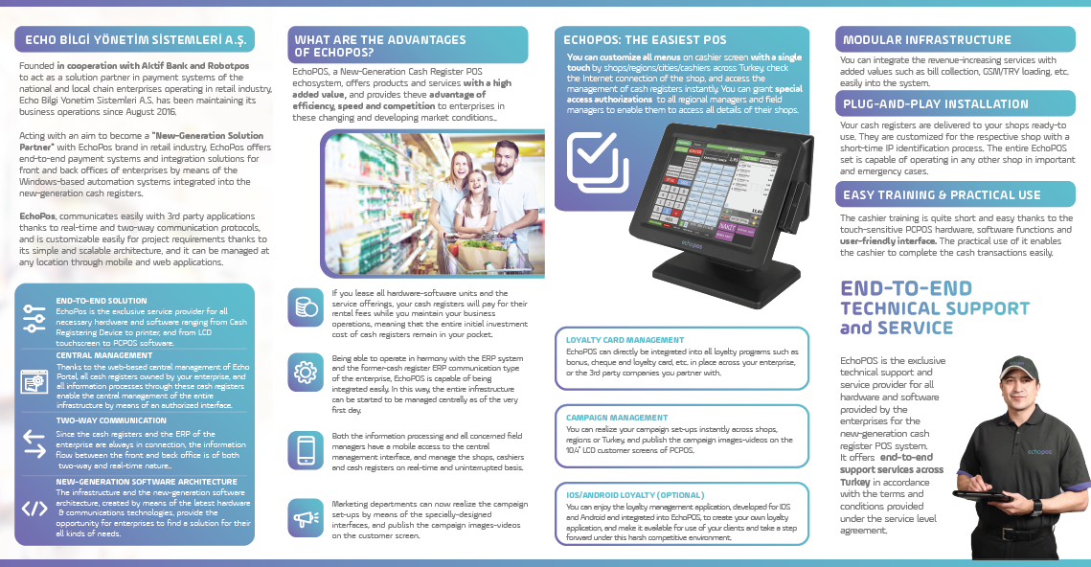
CATALOGUE

Slide 22
CATALOGUE
Please have the QR code read to download the catalog

Slide 23
PROJECTS OF ECHOPOS?

Slide 24
OUR PROJECTS
ECHOPOS / SOK
Normal sales (Cash / Credit Card)
Invoiced Sales (E-archive / E-invoice)
Units Sales
Gift Card Sales
Sok card Payment receipt / Balance inquiry
IBB Payment receipt
Promotions Management
Cash Refund Transactions
Credit Card Cancellation / Refund Transactions
Reflecting and reporting of daily sales to ERP
Ininal Card Balance Loading
Game Pin Loading
Invoice Collection
Transfer Money
Social Card
Paycell-QR Payment
Istanbul Card
ŞOK Food Card
Sodexo FlexoGift
Distance selling

Slide 25
OUR PROJECTS
SOK
NEWLY-OPENED BRANCHES CONTINUE WITH ECHOPOS
*Data for SOK are up-to-date as of 01.10.2024
81
8.431
16.760
PROVINCES
BRANCHES
INSTALLATIONS

Slide 26
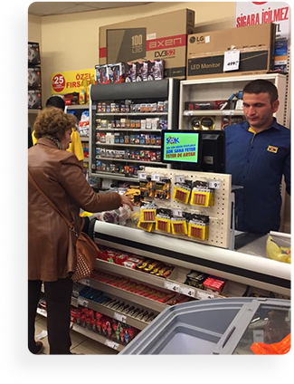
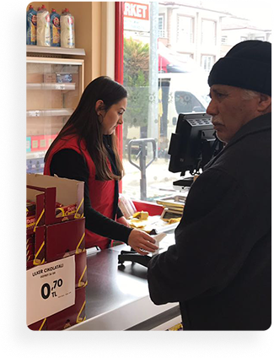
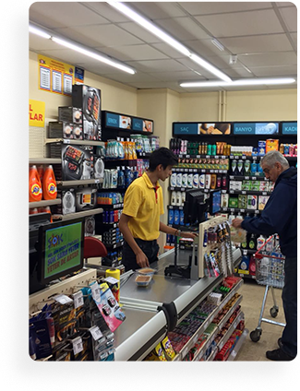
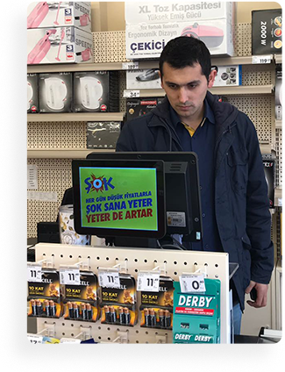
OUR PROJECTS
ECHOPOS / SOK

Slide 27
OUR PROJECTS
ECHOPOS / BIM
Normal sales (Cash / Credit Card)
Invoiced Sales (E-archive / E-invoice)
Units Sales
Gift Card Sales
Bim card Payment receipt
Promotions Management
Cash Refund Transactions
Credit Card Cancellation / Refund Transactions
Cash Register Advance / Payment Transactions
Document Management (Product Transfer/Return to Storage, etc.)
Virtual Product Integration
Open Inventory Installment
Instalment Sales Integration
BIM Money
Change Region

Slide 28
OUR PROJECTS
IN BIM MARKETS
WE ALSO OFFER SERVICES BY MEANS OF BACK OFFICE SOFTWARE
*Data for Bim are up-to-date as of 01.10.2024
23
25
1508
3.528
REGION
PROVINCES
BRANCHES
INSTALLATIONS

Slide 29
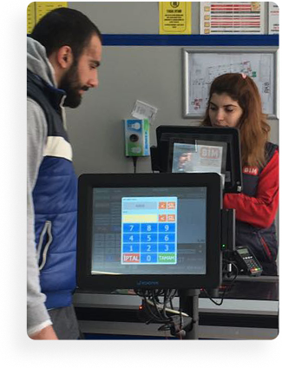
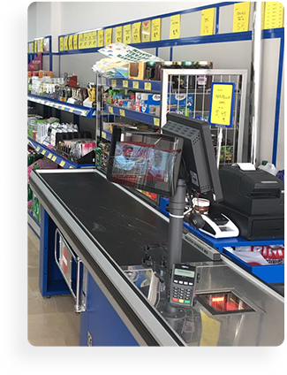
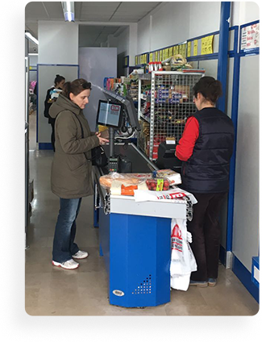
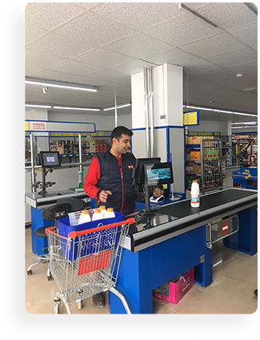
OUR PROJECTS
ECHOPOS / BIM

Slide 30
Please have the QR code read to download the presentation
Esentepe Mah. İnönü Cad. Erdoğan Sok. No:6 Enver Aytaç İş Merkezi Kat:2
Kartal / İSTANBUL
0850 611 00 99
www.echopos.com.tr
info@echopos.com.tr

